Slide 1
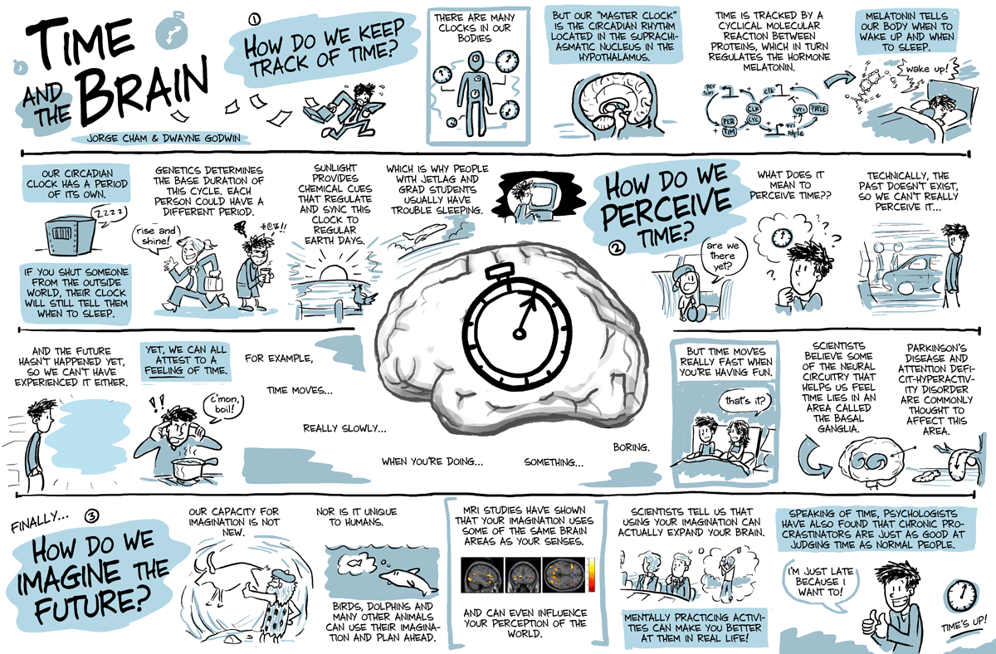

Slide 2
Time Estimation embedded in a general cognitive architecture

Slide 3

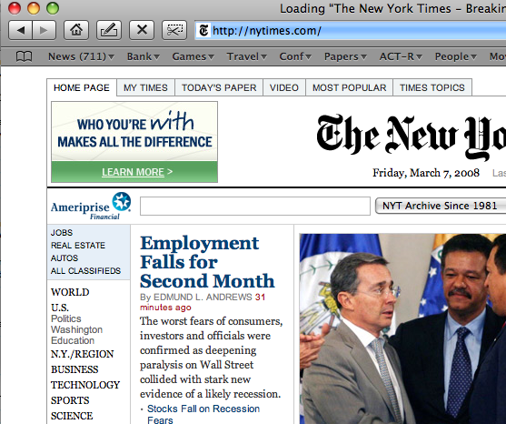

Estimating time is a component of skilled performance

Slide 4
Overview
The time estimation module: how does it work? (Relevant for the assignment)
  Bisection
The two papers: mental manipulation of interval representations
  Memory for time intervals

Slide 5
Time estimation: many models
Pacemaker
Gate
Gate
Accumulator
Attentional gating (Zakay, Block)
Memory
Attention
Start
Signal
Comparison
Internal clock (Gibbon, Meck)
Pacemaker
Gate
Accumulator
Memory
Start
Signal
Comparison

Slide 6
Embed time estimation in a general cognitive architecture
Pacemaker
Gate
Accumulator
Memory
Start
Signal
Comparison
Declarative Module
Goal Buffer
Retrieval Buffer
Matching
Pacemaker
Gate
Accumulator
Productions
Selection
Problem Buffer
Execution
Start
Signal
Taatgen, N. A., Rijn, H. v., & Anderson, J. R. (2007). An Integrated Theory of Prospective Time Interval Estimation: The Role of Cognition, Attention and Learning. Psychological Review, 114(3), 577-598.
Visual Buffer
Manual Buffer
Visual Module
Manual Module
External World

Slide 7
Attention
Temporal Module
ACT-R basically conforms with central bottleneck theories (e.g., Pashler, see Salvucci & Taatgen, 2008)
Declarative Module
Accumulator
Goal Buffer
Retrieval Buffer
Matching
Productions
Selection
Problem Buffer
Execution
Visual Buffer
Manual Buffer
Visual Module
Manual Module
External World

Slide 8
Learning
ACT-R uses a form of instance learning (Logan)
  Experiences with an interval are stored in memory
  Memory is subjected to decay
ACT-R uses rule learning: can explain how judging a particular interval can be automated

Slide 9
Implementation of time estimation
Idea: metronome that starts ticking fast but gradually slows down
The current value of the accumulator is available to the rest of cognition
At any moment, the accumulator can be read or matched in the condition of a production

Slide 10
Example: estimate 6 seconds
Real time
Ticks
8 ticks
Reproduce
“six seconds!”

Slide 11
How long are the pulses?
t₀ = the starting pulse
Noise = logistic noise
Two parameter sets:
t₀ = 11 ms, a = 1.1, b = 0.015
t₀ = 100 ms, a = 1.02, b = 0.015

Slide 12
Assignment for the next two weeks
Implement the ACT-R timing module
  Specifically, you will need
    A function that converts pulses into time
    A function that converts time into pulses
Model Bisection

Slide 13
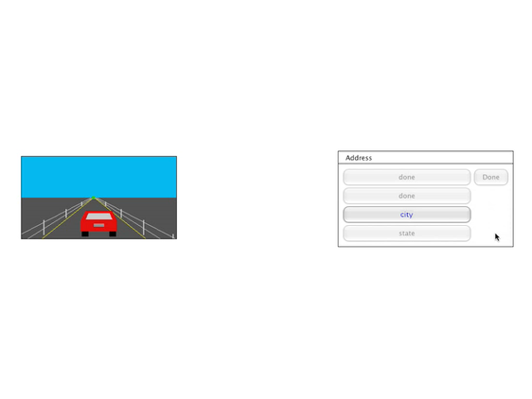
Cognitive Architecture allows modeling time perception in real tasks
(Borst & Taatgen, 2007)

Slide 14
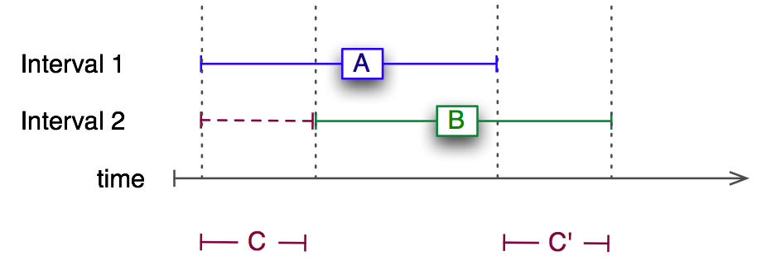
Dual timing paradigm
Interval =
2 sec
Correct =
1.75-2.25 sec
Here you
get a start
signal
Here you
get a second
start signal
Here you
press a key
with left finger
Here you
press a key
with right finger

Slide 15
Model
Respond
when timer
reaches A
Start the
clock
Respond
when timer
reaches A+C
Store
the timer
(C ticks)
van Rijn & Taatgen (2008)

Slide 16
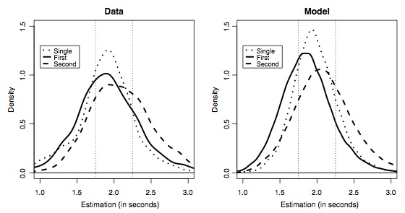
Results

Slide 17
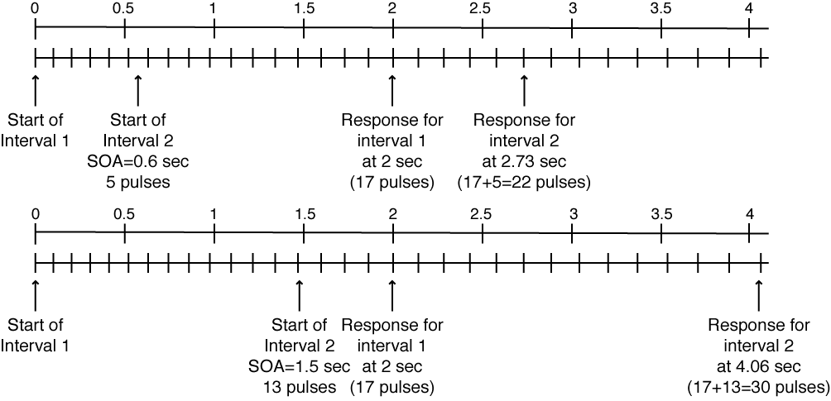
Non-linear scale biases second estimate

Slide 18
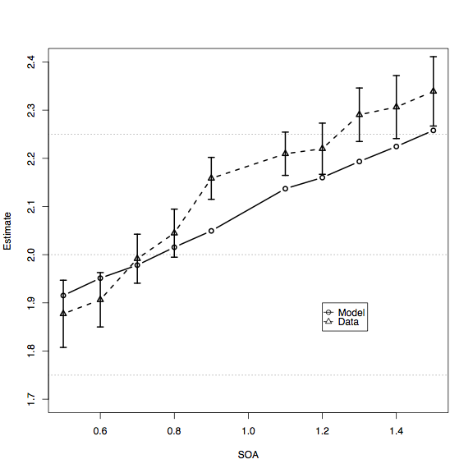
Result: Estimate of second interval as a function of SOA

Slide 19
Relationship between the ACT-R temporal module and the SBF model
Staddon & Higa alternative: decaying memory
Resetting the timer after each interval, can it explain the data?
Will estimation become progressively worse if we have a long series of overlapping intervals?

Slide 20
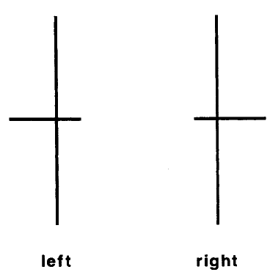
Time estimation: anticipation
Choice-reaction time experiment
The inter-stimulus interval was varied on the last trial of each block

Slide 21
Time-line of a block
Stimulus appears
Participant
decides and
presses key
Inter-stimulus
interval

Slide 22
Design
Lengthening:
ISI = 350ms
last = 467ms
Control:
ISI = 467ms
last = 467ms
Shortening:
ISI = 700ms
last = 467ms

Slide 23
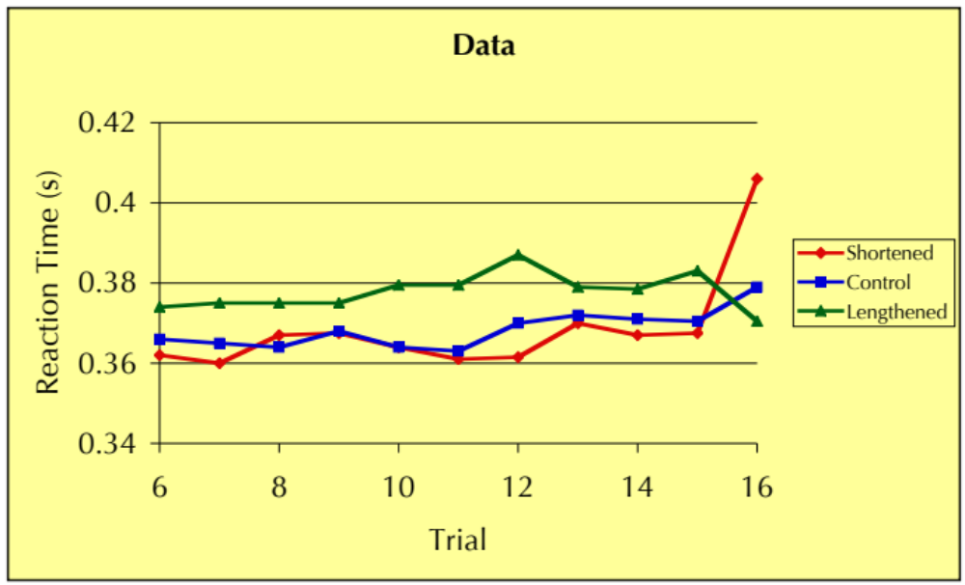
Data

Slide 24
Model
What could be the profit of timing?
If we know when and where the information will be, we can immediately do a +visual> on the location without waiting for the =visual-location>, saving up to 50ms
But if the stimulus is early, we cannot use this advantage, because it will “surprise” us

Slide 25
At the start of the trial we start the timer
(p start-timer
=goal>
isa crt
status nil
==>
+temporal>
isa time
=goal>
status waiting)

Slide 26
When the stimulus comes up, we process it, but also store the time
(p found-visual-location
=goal>
isa crt
status waiting
=visual-location>
isa visual-location
=visual-state>
isa module-state
modality free
=temporal>
isa time
ticks =ticks
==>
+visual>
isa visual-object
screen-pos =visual-location
=goal>
time =ticks
loc =visual-location
status wait-visual

Slide 27
For the next trial, we can try to anticipate the stimulus, and save up to 50ms
(p expect-visual-location
=goal>
isa crt
status waiting
time =ticks
loc =loc
=temporal>
isa time
ticks =ticks
==>
+visual>
isa visual-object
screen-pos =loc
=goal>
status wait-visual)

Slide 28
How does the model save time?
50ms
Stimulus
Real time
Found-
visual-
location
Ticks
8
Next trial
8
Expect-
visual-
location
8
Expect-
visual-
location
7
Found-
visual-
location

Slide 29
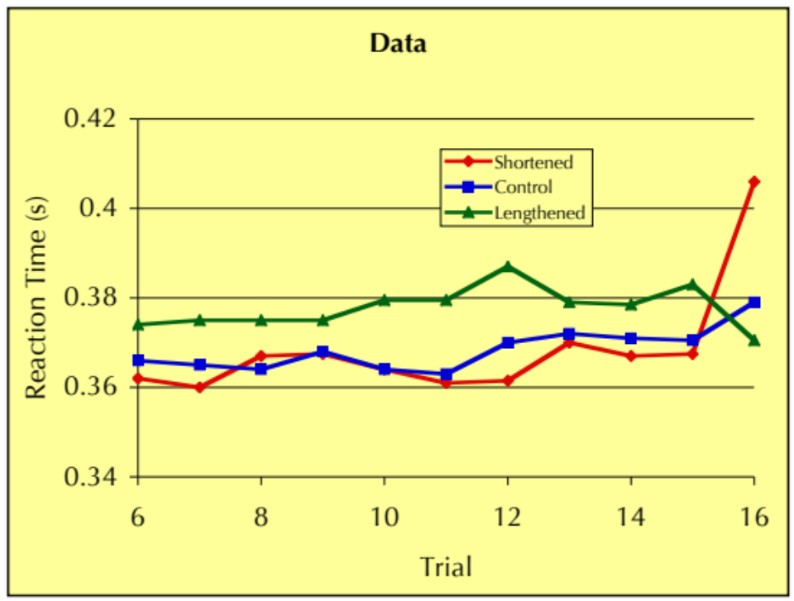
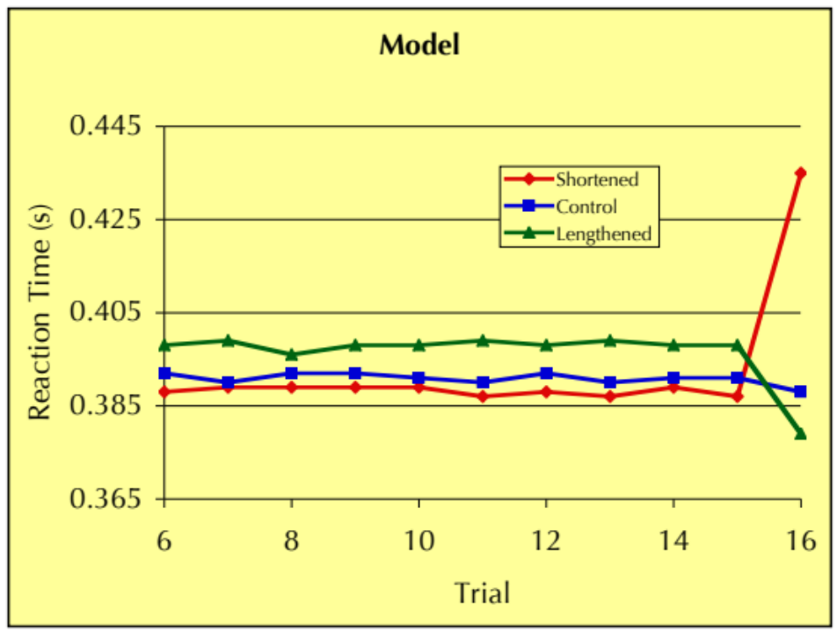
Results of the model with no parameter fitting

Slide 30
What is the goal of this article? Because if you want to look at whether there is a temporal module in the brain or not, is it not easier to use falsification based on simple experiments? Such as, breathing and heart rate should be independent of the interval estimation task. Thus, given that the existence of the temporal module is your hypothesis, what is the advantage of using a cognitive model to test this as compared to simple experiments based on predictions?

Slide 31
In the description of the interval estimation experiments it is mentioned that the participants were forbidden from counting. In general telling people not to think of something immediately makes them think of that particular thing. Would telling them not to count not have a similar effect? If not, would it have any other effect on the outcome of the experiment results, making it more plausible that the model resembles the experiment results, since the model uses some form of counting as well? In other words: would the model still correctly approximate the test results if the participants would not have counted because they did not know they had to keep track of time instead of just being told not to count?

Slide 32
Does the proposed model also explain variances in rhythmic processes that humans produce? (E.g. in drumming, see this paper (http://bit.ly/DrumPaper) discussed in this Sixty Symbols video (https://youtu.be/GyLeBMdI_HU).)

Slide 33
Dikes and Rivers experiment
Goal: investigate the role of memory

Slide 34
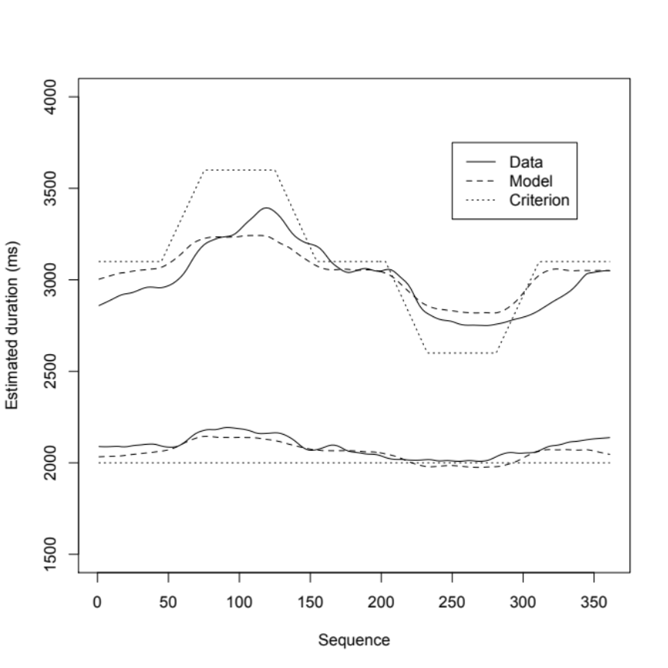
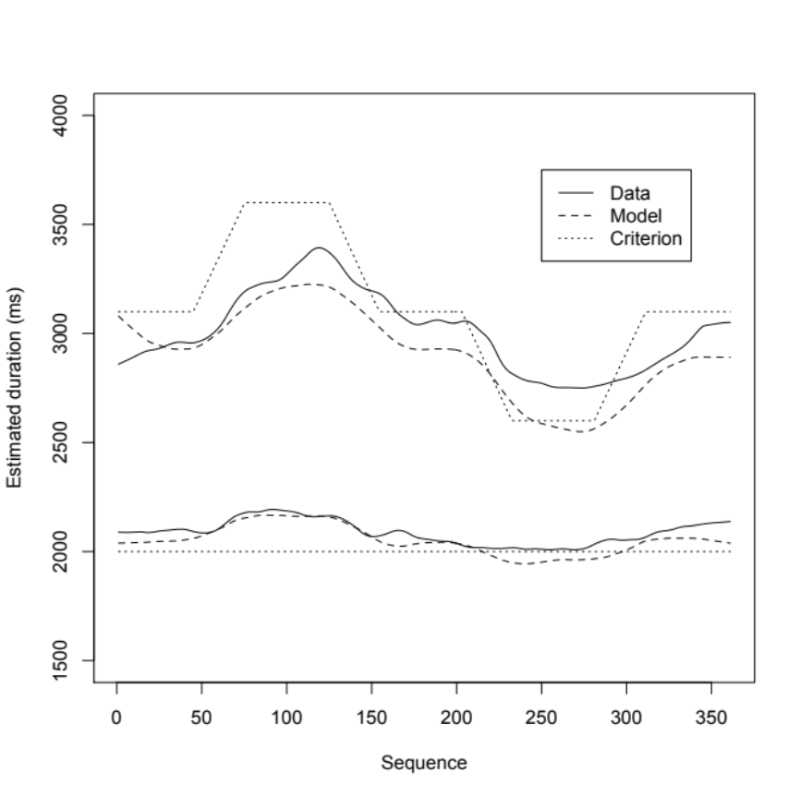
What is a better fit of the data?
R² | RMSE
0.97 | 178
R² | RMSE
0.91 | 229
R² | RMSE
0.81 | 35
R² | RMSE
0.82 | 46
Model A
Model B

Slide 35
Contents
What is the experiment?
What is Model A and Model B?
Why is Model B a better after all?
What lessons can we learn from this example?

Slide 36
Dikes-and-Rivers experiment
Time estimation
In earlier work, we found that if subjects need to memorize two time intervals, these intervals start to ”contaminate” each other
The goal of this experiment is to investigate this contamination in more detail

Slide 37
Experiment
Subjects alternate producing time intervals of a short and a long duration.
Initially, short is 2 seconds and long is 3.1 seconds
They receive feedback on whether their estimate is within +/- 12.5% of the target, and receive “too short” or “too long” as feedback otherwise.
After a number of trials, the criterion for the long interval starts to change.

Slide 38
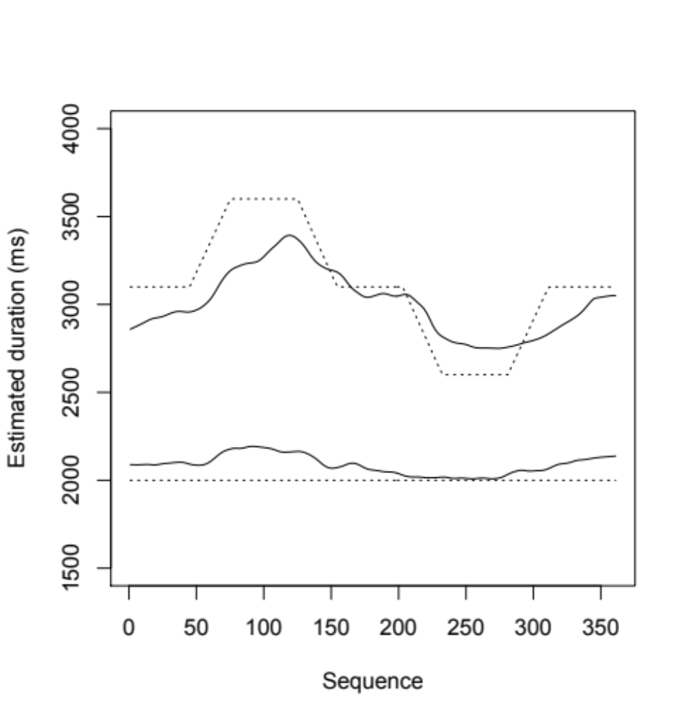
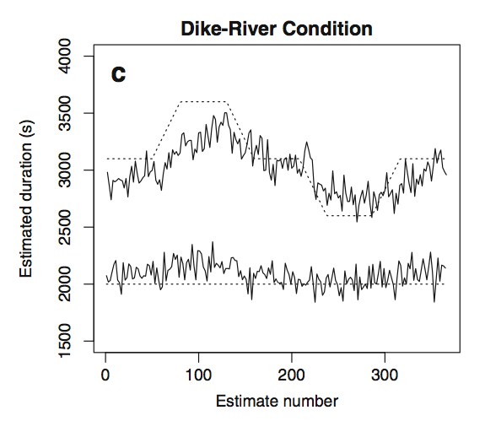
Results

Slide 39
Analysis: Mixed-Effect models
Start with a simple regression equation:
short_{n,s} = β₀ + r_{s} + ε_{n,s}
Then add factors as long as the more complex equation fits the data significantly better than the previous model
short_{n,s} = β₀ + β₁short_{n-1,s} + β₂short_{n-2,s} + r_{s} + ε_{n,s}

Slide 40
Final set of factors for short interval
Fixed Effect | Value of β | t value
Intercept | 657 ms | 4.6
short_{n-1} | 0.385 | 8.3
short_{n-2} | 0.085 | 3.3
short-fb-S_{n-1} | 110 ms | 3.1
short-fb-L_{n-1} | -208 ms | -6.5
long_{n-1} | 0.16 | 5.1
long-fb-S_{n-1} | 92.6 ms | 3.2
long-fb-L_{n-1} | -163 ms | -4.2

Slide 41
For long interval
Fixed Effect | Value of β | t value
Intercept | 695 ms | 3.8
long_{n-1} | 0.34 | 8.5
long_{n-2} | 0.16 | 4.0
long_{n-3} | 0.12 | 4.6
long_{n-4} | 0.05 | 1.9
long-fb-S_{n-1} | 159 ms | 4.8
long-fb-L_{n-1} | -118 ms | -2.5
long-fb-S_{n-2} | 82.9 ms | 2.5
long-fb-L_{n-2} | 3.8 ms | 0.1
short_{n-1} | 0.15 | 2.9
short-fb-S_{n-1} | 85 ms | 2.1
short-fb-L_{n-1} | -107 ms | -6.5

Slide 42
Model
Based on ACT-R’s declarative memory and temporal module, implemented in R
Declarative memory using blending (Lebiere et al., 2007)

Slide 43
Declarative memory with blending
Model uses base-level leaning and a mismatch penalty when on a short/long mismatch:

Slide 44
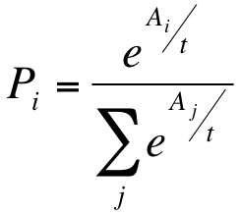
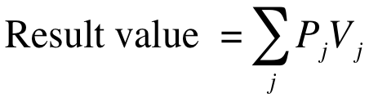
Blending
Each chunk has a probability of being retrieved:
The retrieved interval is a blend of all chunks

Slide 45
How to calculate the blend?
Calculate the activations of all candidate chunks
Apply mismatch penalties to chunks that do not match completely
Example: retrieve a blend for long:
  B(short, 9)=2.0
  B(short,10)=1.0
  B(long,16)=2.0
  B(long,17)=1.5
Apply penalty (of -2):
  A(short, 9)=0.0
  A(short,10)=-1.0
  A(long,16)=2.0
  A(long,17)=1.5

Slide 46
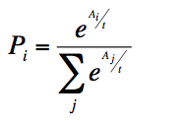
How to calculate the blend?
Now calculate the probability of recall for each of the candidates, using:
Apply penalty:
  A(short, 9)=0.0
  A(short,10)=-1.0
  A(long,16)=2.0
  A(long,17)=1.5
Results in (t=1):
  p(short, 9)=0.076
  p(short, 10)=0.0278
  p(long, 16)=0.558
  p(long, 17)=0.339

Slide 47
How to calculate the blend?
Multiply each probability with the slot value, and add it all up to get the blended value
Probabilities
  p(short, 9)=0.076
  p(short, 10)=0.0278
  p(long, 16)=0.558
  p(long, 17)=0.339
0.076*9 + 0.0278*10 + 0.558* 16 + 0.339 * 17 = 15.65

Slide 48
Contents
Model of Grosjean et al. data
Dikes and Rivers paper
How to model an experiment

Slide 49
Handling feedback
In order to handle feedback, the model also stores the feedback on the previous trial in declarative memory
“Too short” is stored as a positive number, “Too long” as a negative number, and “Correct” as 0.
To determine the number of pulses to wait, the model retrieves the duration and the feedback from memory, and adds these together

Slide 50
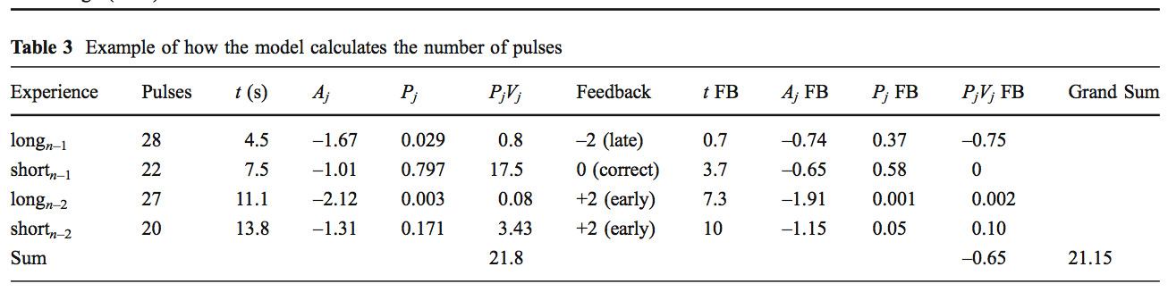

Slide 51
Model A and B are identical, except for parameters
Parameter | Model A | Model B
Noise parameter t | 0.25 | 0.2
Mismatch penalty between short and long for interval retrieval | 1.3 | both 0.92
Mismatch penalty between short and long for feedback retrieval | 0.8
Feedbackshift: how many pulses to add or subtract on the basis of feedback | 8 | 1.8

Slide 52
Once more time the fit
Model A
Model B

Slide 53
Which is better: run the model through the same regression as the data: Short interval
Fixed Effect | β data | β Model A | β Model B
Intercept | 657 ms | 2157 ms | 789 ms
short_{n-1} | 0.385 | 0.08 | 0.356
short_{n-2} | 0.085 | -0.03 | 0.048
short-fb-S_{n-1} | 110 ms | 487 ms | 170 ms
short-fb-L_{n-1} | -208 ms | -521 ms | -153 ms
long_{n-1} | 0.16 | -0.06 | 0.15
long-fb-S_{n-1} | 92.6 ms | 432 ms | 125 ms
long-fb-L_{n-1} | -163 ms | -534 ms | -211 ms

Slide 54
And the long interval...
Fixed Effect | β data | β model A | β model B
Intercept | 695 ms | 3162 ms | 493 ms
long_{n-1} | 0.34 | 0.011 | 0.22
long_{n-2} | 0.16 | 0.012 | 0.25
long_{n-3} | 0.12 | 0.003 | 0.12
long_{n-4} | 0.05 | 0.001 | 0.09
long-fb-S_{n-1} | 159 ms | 626 ms | 198 ms
long-fb-L_{n-1} | -118 ms | -744 ms | -251 ms
long-fb-S_{n-2} | 82.9 ms | 60 ms | 90 ms
long-fb-L_{n-2} | 3.8 ms | -142 ms | -57 ms
short_{n-1} | 0.15 | -0.07 | 0.18
short-fb-S_{n-1} | 85 ms | 326 ms | 20 ms
short-fb-L_{n-1} | -107 ms | -492 ms | -35 ms

Slide 55
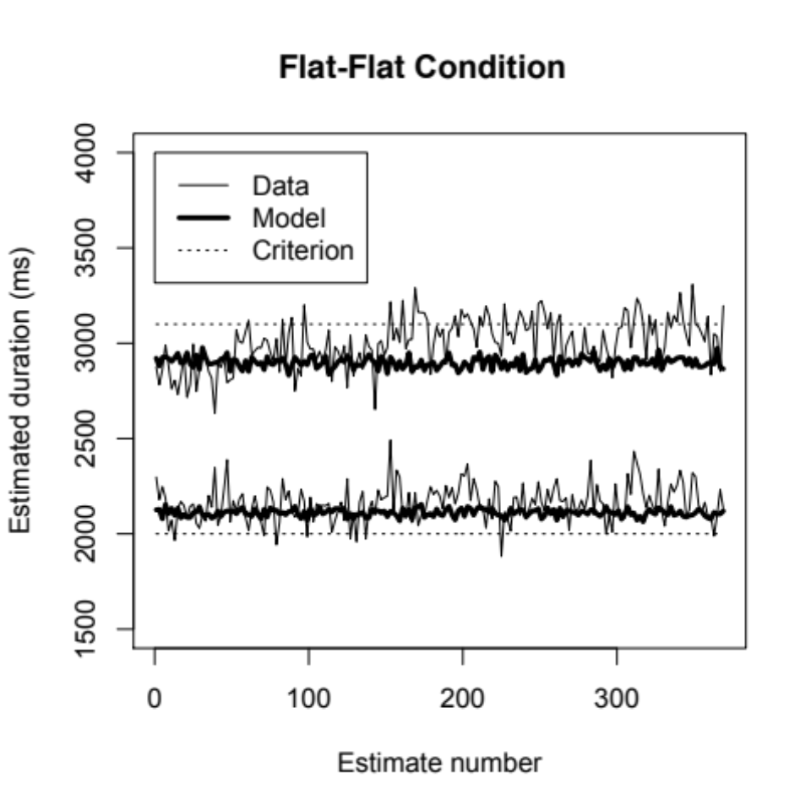
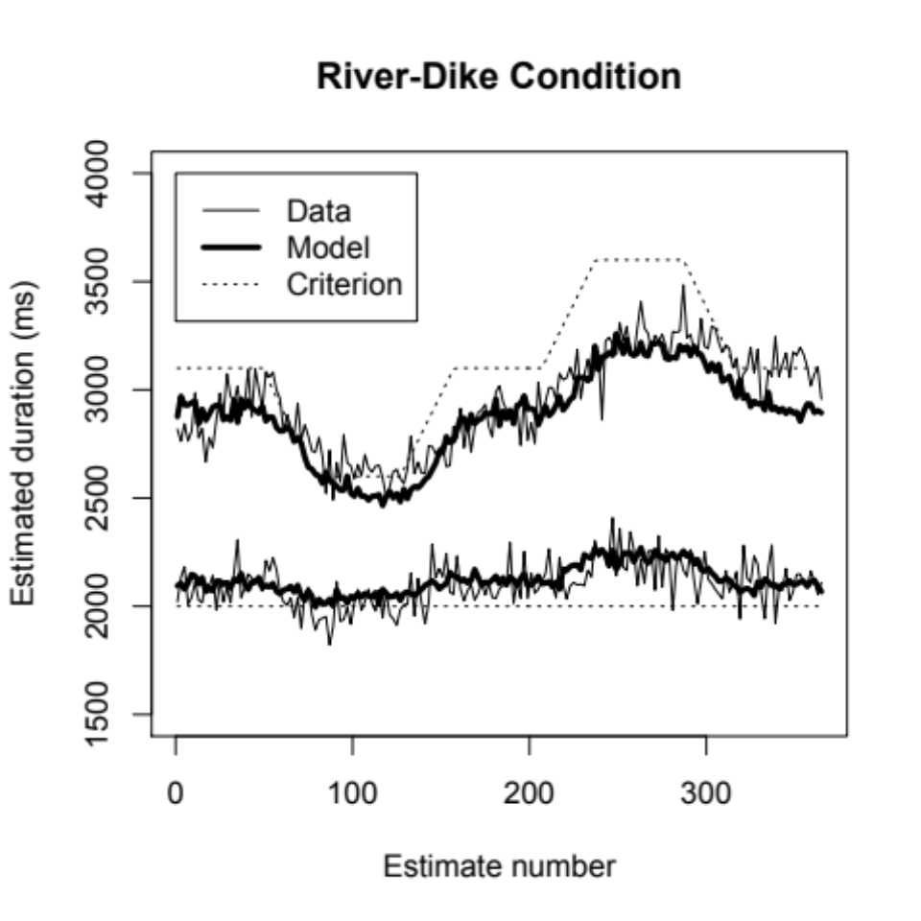
Model predictions

Slide 56
Questions
Regarding the rivers and dikes paper: If time to pulses is logarithmic, but the blending of pulses happens linear, are the changes, the tries a subject needs to find the correct long interval also much further from the target than at the short interval? And can you see the same (larger) slope towards longer durations in these tries? And if trying to compensate for a "too long" has a different effect (because of the larger ticks) than for a "too short", isn't it very hard for subjects to estimate the target without falling into the "too long" region again?

Slide 57
You have shown that the cognitive model results in a better fit, and these are (only for the River-Dike condition?!) compared to alternative models. To help assess the validity of such a model, what is the difference in complexity between these models?

Slide 58
If you would change the +- 12.5% margin of the feedback on the subject's estimate, do you think the results (in particular the RD and DR manifestations) would change, and if so, in what manner? Would the proposed model show similar changes?

Slide 59
In the experiment conducted by the authors, two circles and two colors are used to represent each interval. This allows for spatial location to potentially be added to the memory trace for the presented interval.
That is, the interval could be encoded as a property of the circle, (as would be suggested by a binding pool model (Bowman and Wyble, 2007)). If that is true, than we would expect a greater influence if the intervals are distinguished only by color or only by circle.

Slide 60
Assignment this week
Bisection experiments

Slide 61
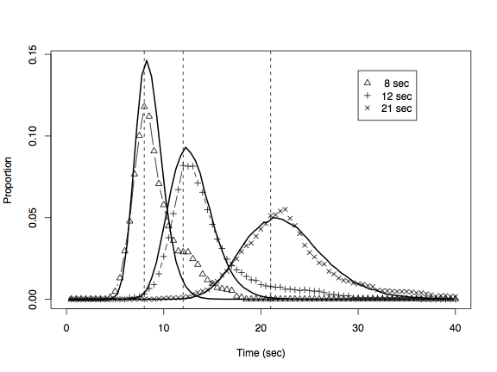
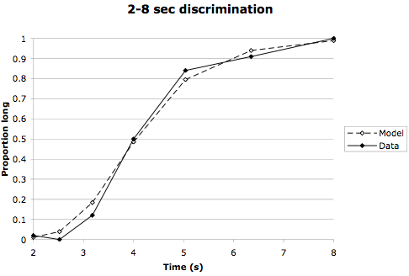
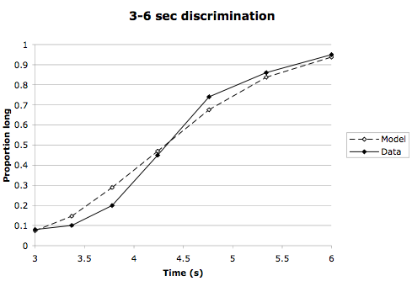
The module can fit basic time interval estimation properties
Scalar property
Data are from Rakitin et al. (1998)
Bisection
Data are from Penney, Gibbon & Meck (2000)

Slide 62
Build a proper experiment
Your model should mimic running an actual experiment
Outer loop for number of subjects
Inner loop in which learn the short and long interval, and then proceed going through the the stimuli
At the end, average the results an plot the graph

